Slide 1
Aiven ON Stationery
2018 New Molded Products
CONFIDENTIAL

Slide 2
V 20170408
New Products:
Paperroll Wireless Desktop Organizer With Wireless Charger
CONFIDENTIAL

Slide 3
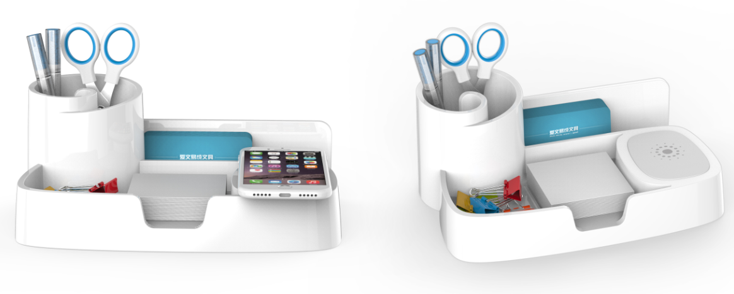
Paperroll Wireless Charging Desktop Organizer
Model No.：62115301
Packing：1/ color box
MOQ：3000pcs/product
Material：ABS
Selling points
Multi-functional office desktop storage：Storage+ Wireless Charging
Unique, modern design
Stores paper clips, pens, push pins, notepad etc. Helps to de-clutter desktop.
Easy use. Just connect the organizer with a USB2.0 Standard outlet and the wireless charger can charge the mobile phone standing up or laying flat.
Supports Windows 7, Vista, XP, 2003/2000/ME, Mac OS X and Linux Systems, no need of any driver.
CONFIDENTIAL

Slide 4
CONFIDENTIAL

